Slide 1


BSAN 400 Machine Learning Presentation
Spotify Audio Features
Hallie Edwards
Building a predictive model to determine if I will like a song or not based on its audio features.
https://github.com/hredwards/SpotifyMLExploration

Slide 2
Presentation Outline
Background:
Goal
Data Background and Tools Used
Analysis:
Exploratory Data Analysis (EDA)
Modeling and Predictions
Generalized Linear Models
Reduced Models (manual, stepwise/forward/backward regression)
Classification Trees
Advanced Models (Bagging, Random Forest, Boosting, eXtreme Gradient Boosting)
Relevance and Future Analysis:
How Spotify Does it
Genre Classification, Lyric Analysis (for logit models and genre classification), using model parameters to create a playlist
Spotify Audio Features Machine Learning Project
https://github.com/hredwards/SpotifyMLExploration

Slide 3
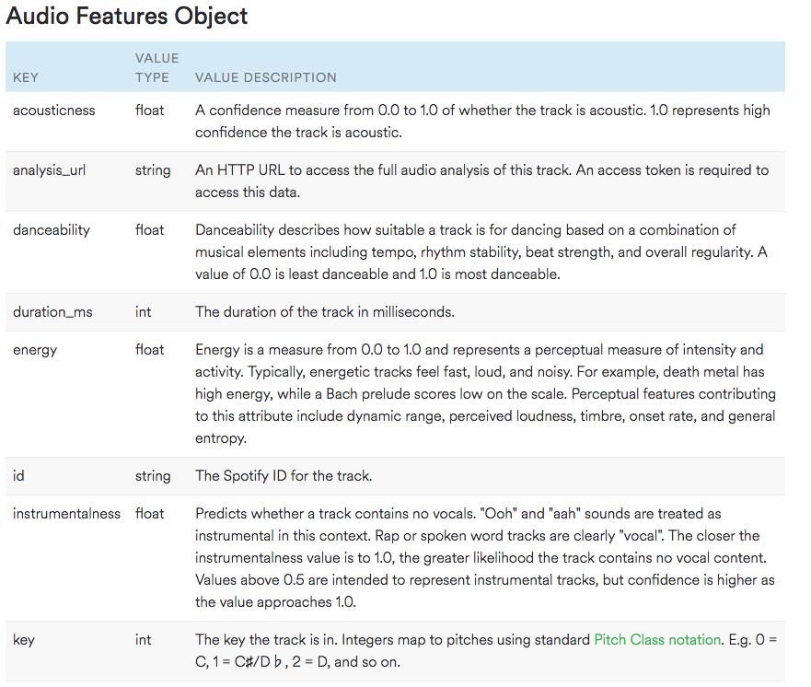
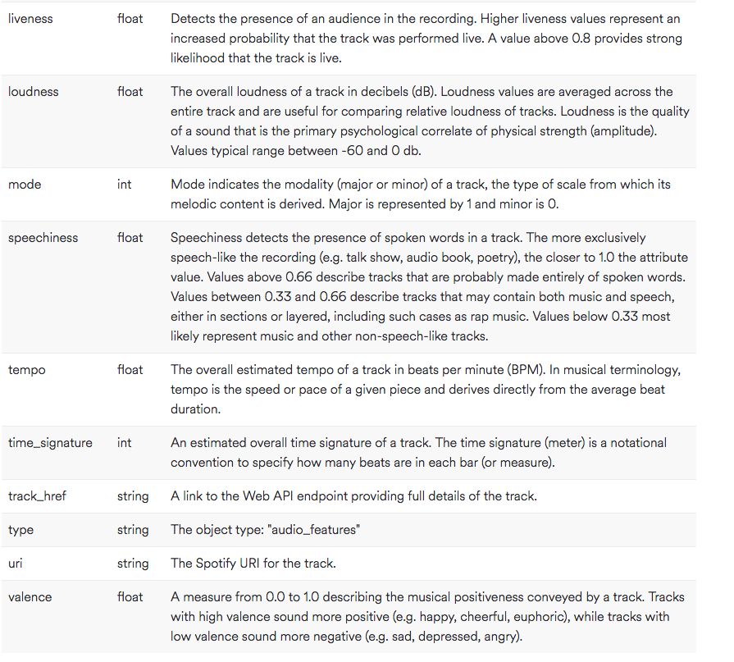
Goal
Building a predictive model to determine if I will like a song or not based on its audio features.
Spotify Audio Features Machine Learning Project
https://github.com/hredwards/SpotifyMLExploration

Slide 4
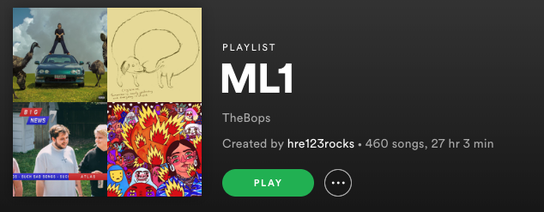
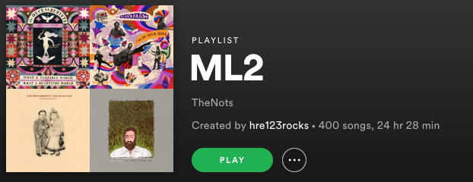
Data Background and Tools Used
Data:
2 playlists I personally made, 860 songs total
460 “Like”, 400 “Dislike”
Intentional about mixing genres in both
Have songs in both playlists from the same artists
Training:Test split was 80:20
Tools:
Spotify API
Used to create a client to access my personal playlist data
Python
Packages: Spotipy, Pandas
Used to pull the audio feature data from the Spotify API and convert it to a csv
RStudio
Used for data analysis and visualization
Spotify Audio Features Machine Learning Project
https://github.com/hredwards/SpotifyMLExploration

Slide 5
Exploratory Data Analysis (EDA) Findings
Speechiness and Liveness initially seem to have a potential relationship to my rating.
Danceability, Energy, Loudness, Acousticness, Valence, and Key all initially seem to have a relationship to my rating.
Tempo, Duration and Instrumentalness don’t initially seem to have a relationship to my rating.
Spotify Audio Features Machine Learning Project
https://github.com/hredwards/SpotifyMLExploration

Slide 6
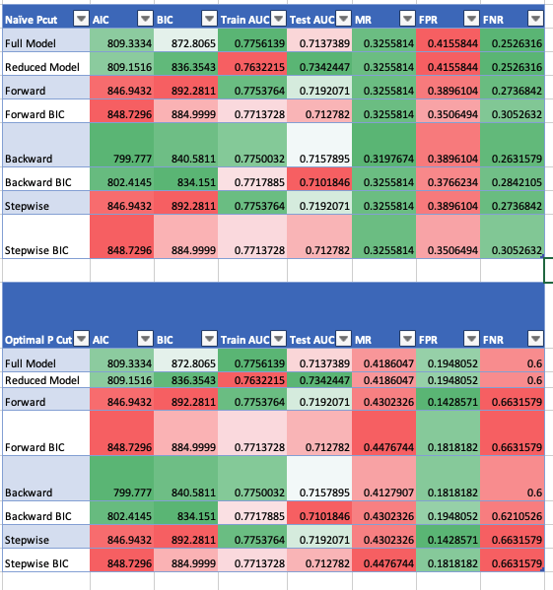
Generalized Linear Models and Reduced GLMs
Full Model: danceability + energy + key + loudness + mode + speechiness + acousticness + instrumentalness+ liveness + valence + tempo + duration_ms + time_signature
Reduced Model: danceability + energy + key + mode
Forward: energy + danceability + valence + key + mode + duration_ms + speechiness + liveness
Backward: danceability + energy + key + mode + speechiness + liveness + valence + duration_ms
Stepwise: energy + danceability + valence + key + mode + duration_ms + speechiness + liveness
Forward BIC: energy + danceability + valence + key + mode + duration_ms
Backward BIC: danceability + energy + key + mode + valence + duration_ms
Stepwise BIC: energy + danceability + valence + key + mode + duration_ms
Spotify Audio Features Machine Learning Project
https://github.com/hredwards/SpotifyMLExploration

Slide 7
Classification Trees
Classification Tree with CP of 0.018
Large Classification Tree with CP Plot
Classification Tree with CP of 0.0045 after accounting for asymmetric cost (1:10 FN:FP)
Spotify Audio Features Machine Learning Project
https://github.com/hredwards/SpotifyMLExploration

Slide 8
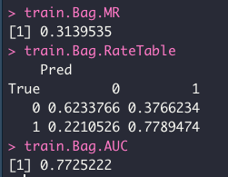
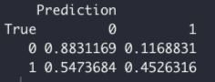
Bagging
Using Optimal P-Cut of 0.73 based on 3:1 FP:FN weight results in lower false positives with the tradeoff of lower true positives
Spotify Audio Features Machine Learning Project
https://github.com/hredwards/SpotifyMLExploration

Slide 9
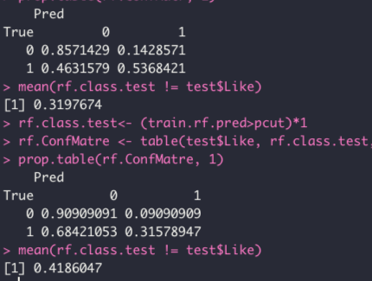
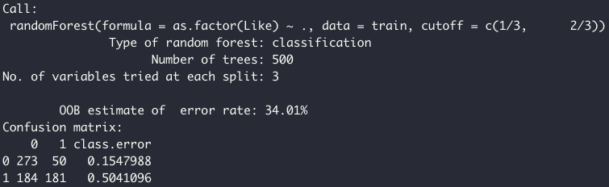
Random Forest
Using Optimal P-Cut of 0.73 based on 3:1 FP:FN weight results in lower false positives with the tradeoff of lower true positives
AUC of 0.7857143
Spotify Audio Features Machine Learning Project
https://github.com/hredwards/SpotifyMLExploration

Slide 10
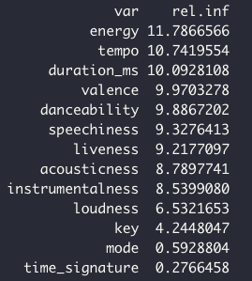
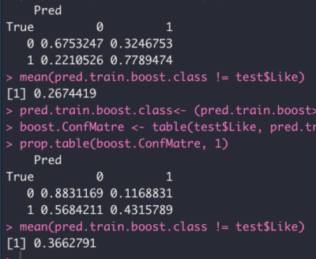
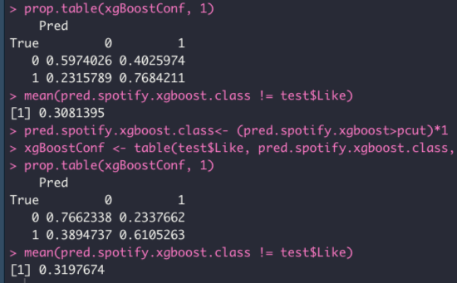
Boosting and eXtreme Gradient Boosting
AUC of 0.7838688 on test set
gbm.perf reports 86 as optimal amount of trees
XGBoost had AUC of 0.7604921 on test set
Spotify Audio Features Machine Learning Project
https://github.com/hredwards/SpotifyMLExploration

Slide 11
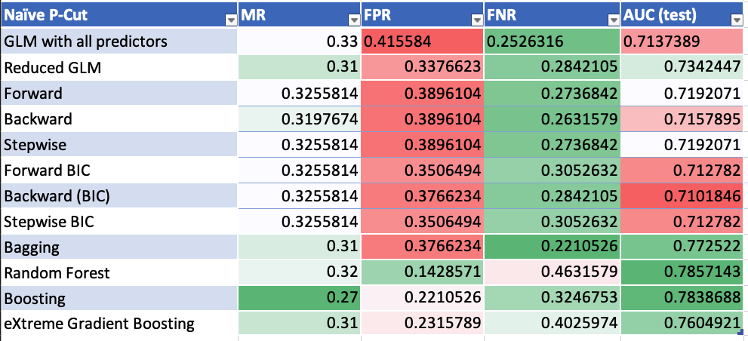
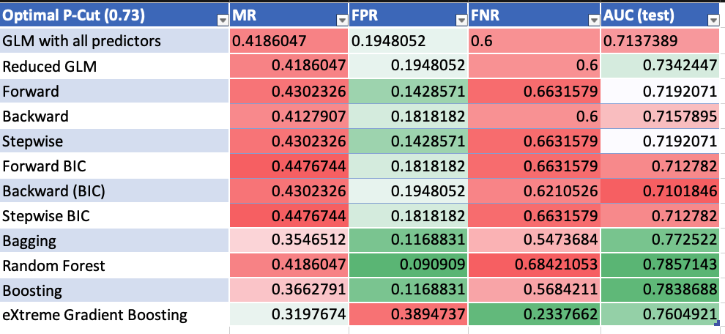
Comparison of Models
Spotify Audio Features Machine Learning Project
https://github.com/hredwards/SpotifyMLExploration

Slide 12
Relevance and Future Analysis
How does Spotify do it?
Collaborative Filtering – recommendations based on users with similar tastes
Natural Language Processing (NLP) – scouring articles, blogs, and song metadata to generate tags associated with songs and comparing tags amongst songs
Raw Audio Models – similar to what I’ve done here (but likely much more advanced, especially since they have all songs and users data)
Composing music with Francois Pachet
Future Analysis:
Genre Classification
KNN, Decision Trees, Neural Networks
Lyrical Analysis (both as a logit for Like or Dislike and as a classification of genre)
Sentiments of lyrics, frequency
Playlist Suggestions
Using parameters identified in model to create a new playlist of songs the model predicts I would like
Spotify Audio Features Machine Learning Project
https://github.com/hredwards/SpotifyMLExploration

